Slide 1
IN THE NAME OF GOD

Slide 2
Management of Immunosuppressive Drugs in Covid-19 Infection

Slide 3
Managing immunosuppression
Managing immunosuppression in these patients is challenging and should take into account
Age,
Severity of COVID-19 infection,
Associated comorbidities,
Time post-transplant
The risk of acute allograft rejection: In all cases the decision to reduce immunosuppression must be carefully weighed against the risk for acute rejection, particularly in transplant recipients who generally require high levels of maintenance immunosuppression (eg, first two months after transplantation, patients with second time transplantation, transplantation in sensitized patients, lung or heart recipients).

Slide 4
Lopez V etal, Recommendations on management of the SARS-CoV-2 coronavirus pandemic (Covid-19) in kidney transplant patients. Nefrologia. 2020 May-Jun;40(3):265-271. English, Spanish. doi: 10.1016/j.nefro.2020.03.002. Epub 2020 Apr 3. PMID: 32278616; PMCID: PMC7129342.

Slide 5
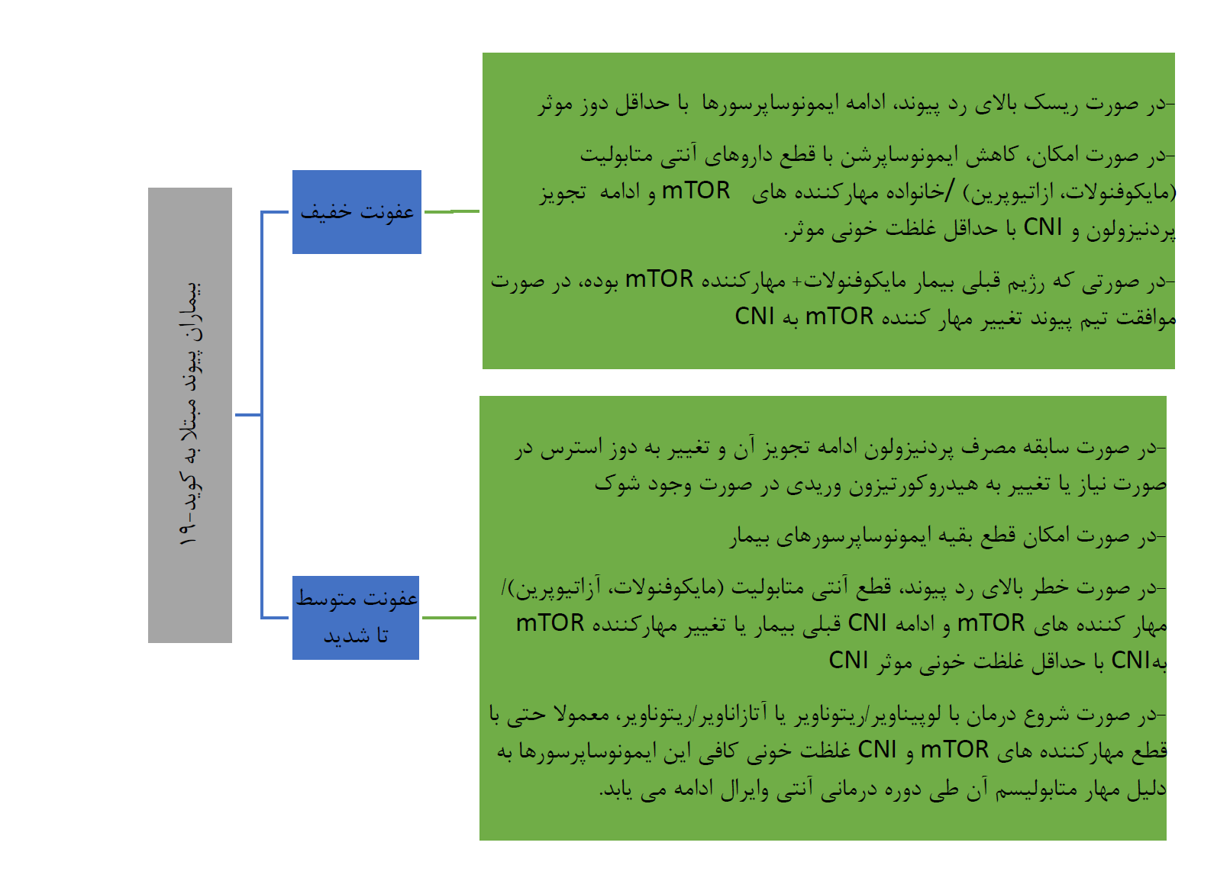
شخیص و درمان بیماری کووید
فلوچارت - 19 در سطوح ارائه خدمات سرپایی و بستری

Slide 6
Coll E et al,COVID-19 in transplant recipients: The Spanish experience. Am J Transplant. 2020 Oct 23. doi: 10.1111/ajt.16369. Epub ahead of print. PMID: 33098200.

Slide 7
Adjustment of baseline immunosuppression in solid organ transplant recipients with COVID-19
Coll E et al,COVID-19 in transplant recipients: The Spanish experience. Am J Transplant. 2020 Oct 23. doi: 10.1111/ajt.16369. Epub ahead of print. PMID: 33098200

Slide 8
Could long-term immunosuppression potentially protect SOT recipients from developing the exacerbated inflammatory response?
It has been suggested that long-term immunosuppression could potentially protect SOT recipients from developing the exacerbated inflammatory response triggered by SARS-CoV-2.
However, our experience suggests a particularly severe course in transplant patients with respect to the overall nontransplant population.
The 27% mortality rate in this cohort is similar to that reported in the largest COVID-19 transplant series published so far.
The more aggressive course of infection after transplantation may be due to the effects of chronic immunosuppression, but also to demographics and baseline comorbidities (eg, cardiovascular risk factors) of this group of patients compared to the general population.
In fact, when we adjusted the COVID-19 case-fatality rate after transplantation to match the age and gender of the Spanish general population, it decreased to 15.8% (data not shown).
Coll E et al,COVID-19 in transplant recipients: The Spanish experience. Am J Transplant. 2020 Oct 23. doi: 10.1111/ajt.16369. Epub ahead of print. PMID: 33098200

Slide 9
Risk stratification and scoring
Disease severity
- Mild
- moderate and sever
Risk of rejection
- Low
- High

Slide 10
Sirolimus
Reduced counts and functional exhaustion of T lymphocytes, and cytokine release syndrome have been identified as adverse factors in patients affected by severe SARS-CoV-2 infection . Severe COVID- 19 can therefore mimic a state of immune senescence.
mTOR is a central regulator of inflammation within the immune system and a sensor of oxidative stress.
The aim of this letter is to discuss the potentiality for rapamycin , an mTOR inhibitor, to restore T-cell functionality and decrease cytokine storm.

Slide 11
Sirolimus
mTOR forms two complexes: mTORC1 mediates TH1 and TH17 differentiation at the time of viral antigenic presentation by dendritic cells (DC) ; mTORC2 mediates TH2 differentiation; while both complexes restrict regulatory T-cell (Treg) differentiation.
COVID-19 expands TH17 cells further supporting a TH17 type cytokine storm in this disease .
In patients infected with the H1N1 influenza virus, early adjuvant rapamycin therapy during a short period (2 mg/day for 14 days) was significantly associated with an increased viral clearance, a greater improvement in lung injury (i.e. less hypoxemia), and a decrease of multiple organ dysfunction. The duration of ventilation in survivors was also shortened.

Slide 12
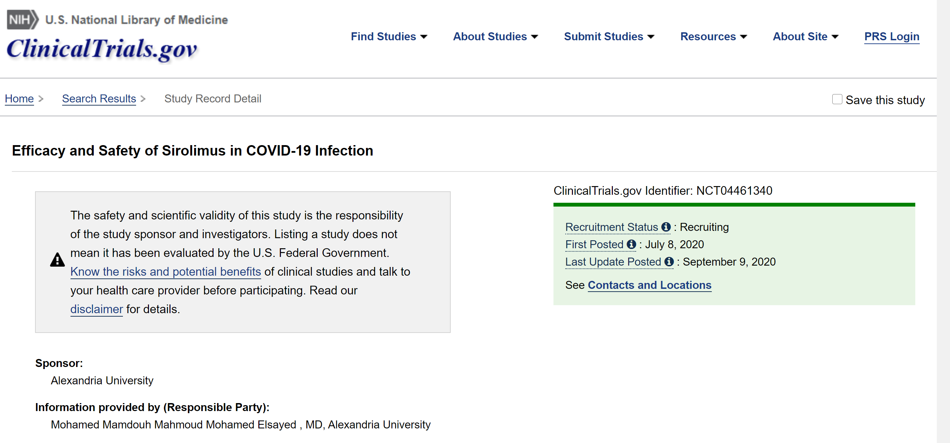

Slide 13
